Slide 1
Plant diversity and the importance of herbaria
Dora Ann Lange Canhos
dora@cria.org.br

Slide 2
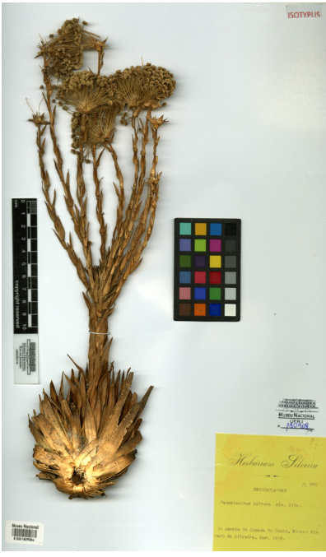
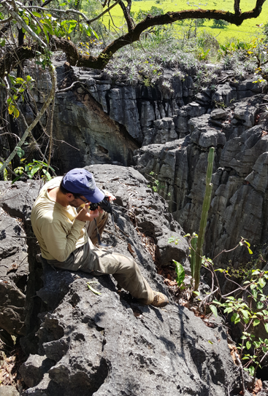
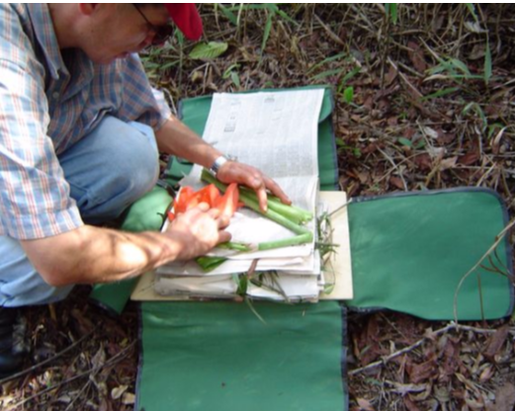
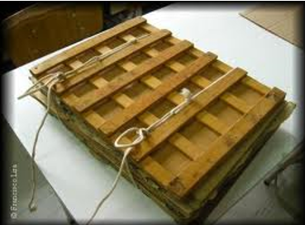
What is a herbarium?
Basic information (label):
  Collection data: who, when, where
  Identification: species name*, who, when
  Other: flower, fruit, characteristics
  Unique identifyer: collection code and number
  * Carl Linnaeus - system for naming, ranking, and classifying organisms (binomials). Species Plantarum 1753

Slide 3
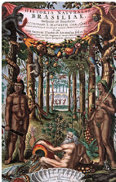
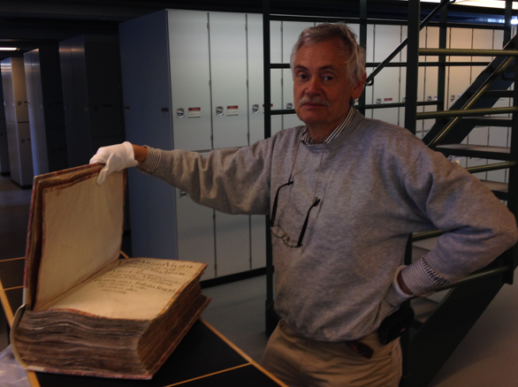
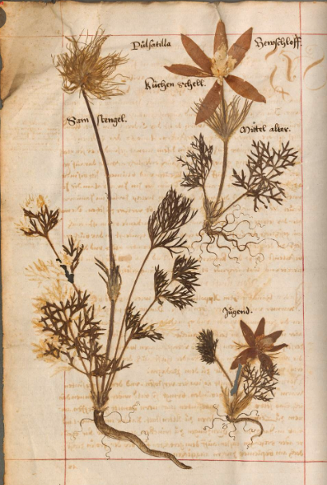
Why are herbaria so important?
Data since 1637: Georg Marcgrave (1610-1644)
First herbarium with plants
from Brazil: Herbarium vivum
Brasiliensis of plants collected
in Pernambuco (1637 – 1644)
Natural History Museum
Denmark (C).
Historia Naturalis
Brasiliae

Slide 4
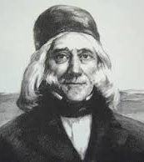
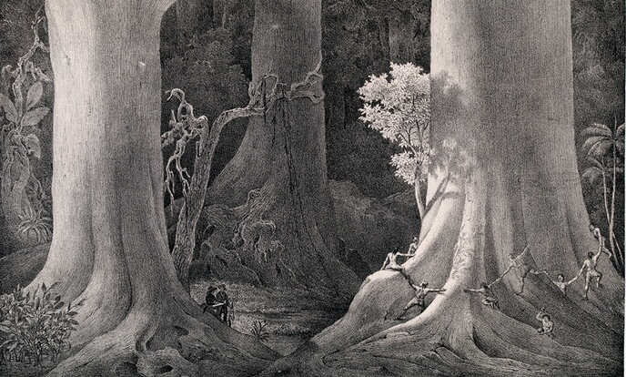
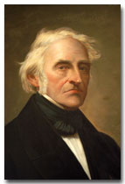
Why are herbaria so important?
Martius & Spix collected specimens 1817-1820
Saint-Hilaire (1779-1853)
Travels in Brazil (1816-1822)
ES, RJ, MG, GO, SP, SC, RS, Argentina, Paraguay
See hvsh.cria.org.br
Flora brasiliensis – 22,767 species
Published 1840 – 1906
See fb.cria.org.br

Slide 5
Index Herbariorum 2019 – Top 100
Kew Gardens (K) – 8,125,000
MNHN (P) – 8,000,000
NYBG (NY) – 7,921,000
Naturalis – 6,900,000
MOBOT – 6,850,000
RAS (Russia) – 6,000,000
Wien – 5,500,000
British Museum – 5,200,00
Smithsonian – 5,100,00
Harvard University – 5,005,000
Brazil
65. JBRJ – 780,000
81. Museu Nacional – 600,000
96. Instituto de Botanica – 500,000
Brazil`s Virtual Herbarium 5,755,000
The importance of sharing data through a common e-infrastructure!

Slide 6
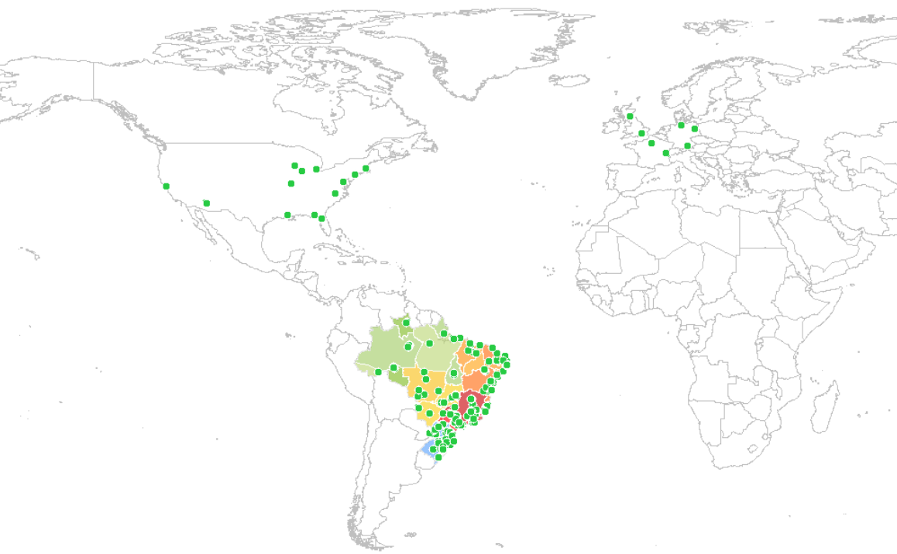
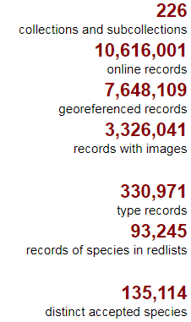

Slide 7
Why are herbaria so important?
Biodiversity libraries
Data and vouchers (samples)
  Can be reanalyzed and reidentified following the evolution of science
Uses: Research, Education, Services, Policy
  Environmental management and environmental impact studies
  Endangered species list
  Climate Change
  New products (pharmaceuticals)
  Conservation Areas

Slide 8
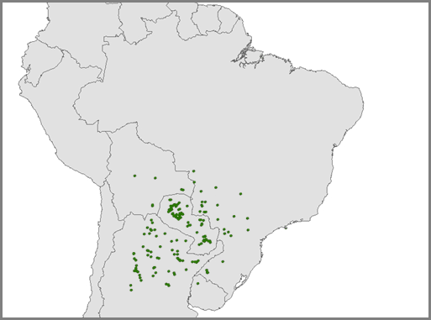
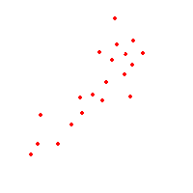
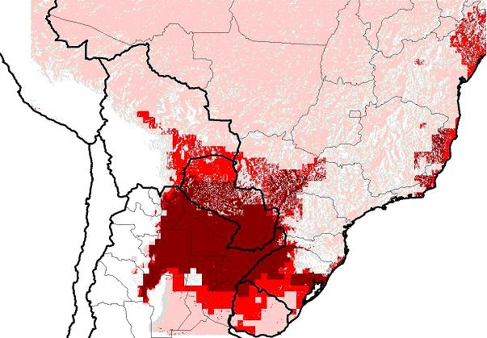
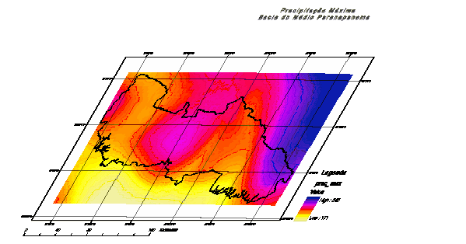
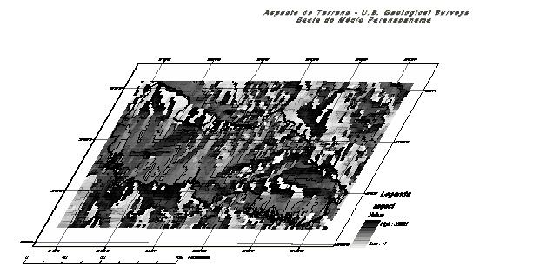
Data usability - modeling
Environmental conditions where a species occurs
Occurrence points
Environmental variables
Temperature
Potential distribution map
Rainfall
modelo
identifies
Temperature
Algorithm defines environmental conditions
Rainfall
Slide: Renato De Giovanni

Slide 9
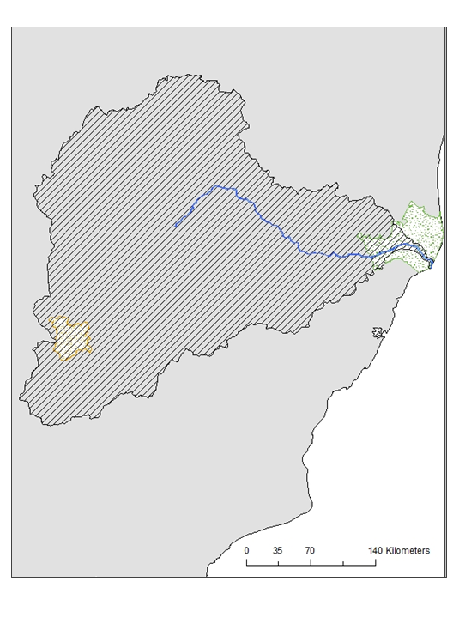
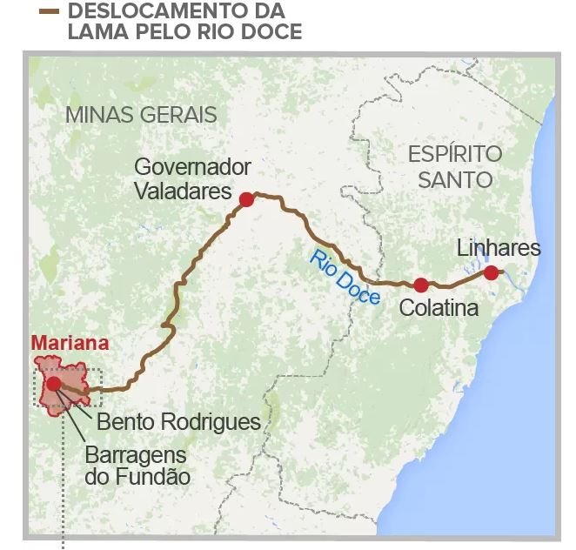
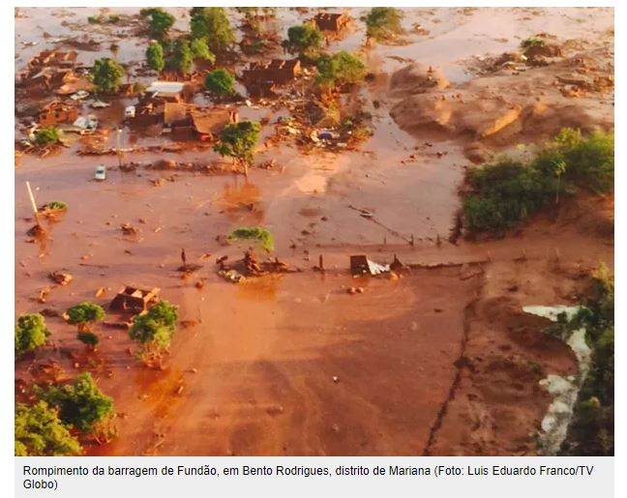
Disaster in Mariana: mud displacement accross Rio Doce

Slide 10

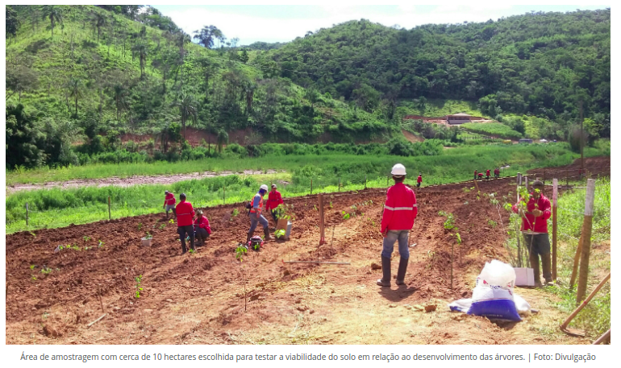
Planting new trees is good!
The questions of our Project are:
How will climate change affect the trees that are being planted today in the Rio Doce Basin?

Slide 11
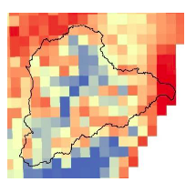
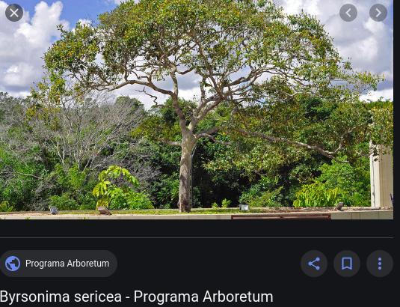
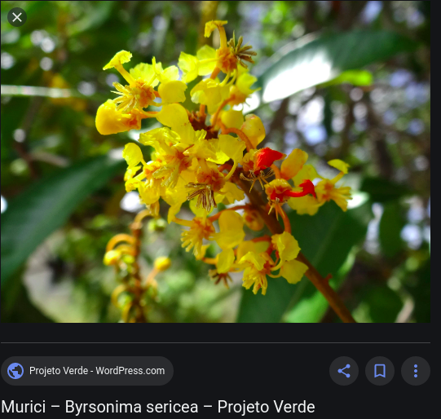
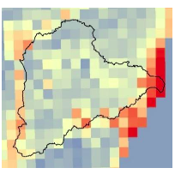
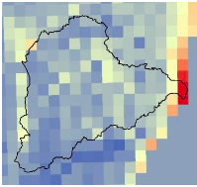
Tree: Murici (scientific name Byrsonima sericea)
Present climate
What happens in 50 years time?
Worse climate
Better climate
Future climate 1
Future climate 2
1. More optimistic future (same greenhouse gas emission)
2. More pessimistic future (greater greenhouse gas emission)
Conclusion: the tree may lose areas even with the best scenario!!!

Slide 12
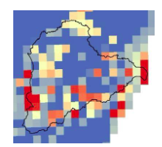
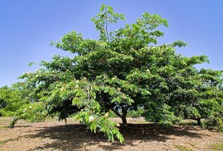
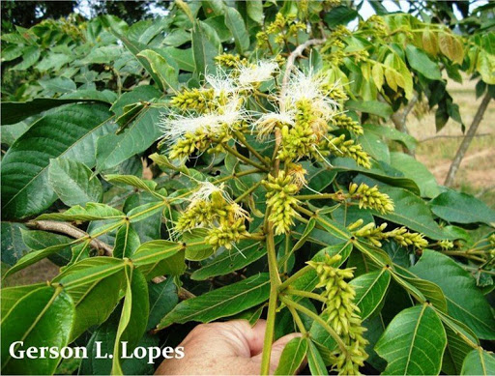
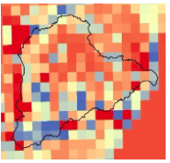
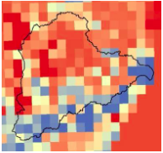
Tree: Ingá (scientific name Inga edulis)
Present climate
What happens in 50 years time?
Worse climate
Best climate
Future climate 1
Future climate 2
1. More optimistic future (same greenhouse gas emission)
2. More pessimistic future (greater greenhouse gas emission)
Conclusion: the tree may gain areas in both scenarios!!!

Slide 13
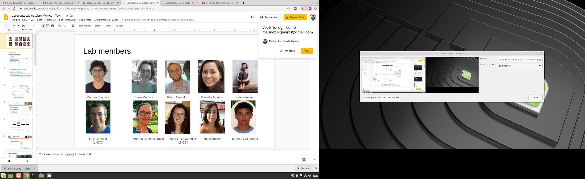

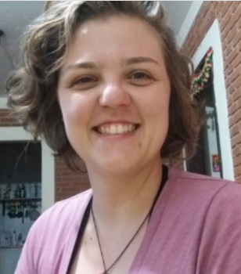

The effect of climate change in plants used to restore the Rio Doce basin
Conclusion: of the 19 trees studied, 4 may lose areas and 15 may gain areas with good environmental conditions, which is great news !!!! However, these areas may not be where the trees were planted.
The future is uncertain!! It is great to plant new trees, but you need to know which and where, so that the result is the best possible!!
Equipe NCCG/JBRJ
Marinez Siqueira Sara Mortara Bruno Carvalho Danielle Moreira Kele Firmiano
Andrea Sánches-Tapia Tainá Rocha Ana Devides Talita Zupo

Slide 14
Biodiversity and Climate Change
Biodiversity loss
Less Carbon fixation
Greater impact on Climate Change
Losing what we don’t know
Affects ecosystem services (water resources, pollination) and human wellbeing
Extreme events: drought, floods ...

Slide 15

Thank you!
Dora

